Slide 1
Aspnetcore Razor Pages
Sarita Lad

Slide 2
Razor Pages are….
Razor Pages is a server-side programming model that makes it easy to build web applications with a focus on simplicity and productivity. Each Razor Page typically corresponds to a specific URL route and is processed on the server side, generating HTML that is sent to the client's browser.

Slide 3
What Is Razor Pages?
Introduced as part of ASP.NET Core, and now included in .NET 5, ASP.NET Razor Pages is a server-side, page-focused framework that enables building dynamic, data-driven web sites with clean separation of concerns. Part of the ASP.NET Core web development framework from Microsoft, Razor Pages supports cross platform development and can be deployed to Windows, Unix and Mac operating systems.
The Razor Pages framework is lightweight and very flexible.
It provides the developer with full control over rendered HTML.
The easy-to-learn Razor templating syntax for embedding C# in HTML mark-up
It is based on a page-centric development model,

Slide 4
Difference between MVC and Razor Pages
The key difference between Razor Pages implementation of the MVC pattern and ASP.NET Core MVC is that Razor Pages uses the Page Controller pattern instead of the Front Controller pattern.

Slide 5
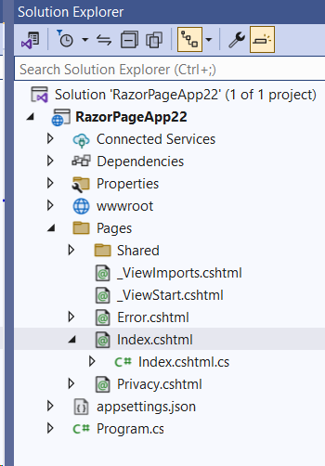
Structure of Project
Razor Page:
All Razor files end with .cshtml
Content Pages
For a file to act as a Razor content page, it must have three characteristics:
It cannot have a leading underscore in its file name
The file extension is .cshtml
The first line in the file is @page

Slide 6
Razor Syntax
Razor Syntax
Content pages are largely comprised of HTML, but they also include Razor syntax which enables the inclusion of executable C# code within the content. The C# code is executed on the server, and typically results in dynamic content being included within the response sent to the browser.

Slide 7
PageModel Files
The recommended way to develop Razor Pages applications is to minimise the amount of server-side code in the content page to the barest minimum. Any code relating to the processing of user input or data should be placed in PageModel files, which share a one-to-one mapping with their associated content page. They even share the same file name, albeit with an additional .cs on the end to denote the fact that they are actually C# class files.

Slide 8
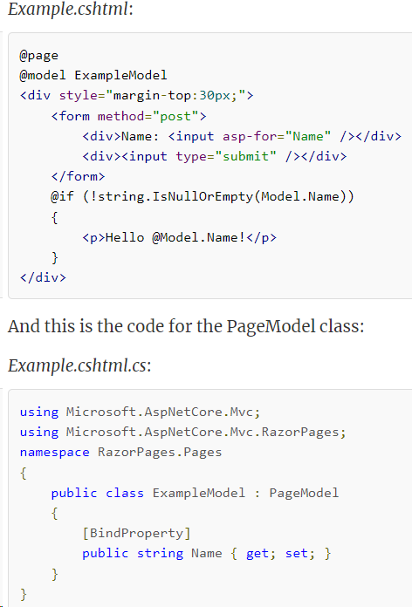
The following code shows the Example.cshtml file adapted to work with a PageModel:

Slide 9
What is request Pipeline middleware?
When requests are made to a web application, they need to be processed in some way. A number of considerations need to be taken into account.
Where should the request be directed or routed to?
Should details of the request be logged?
Should the application simply return the content of a file?
Should it compress the response?
What should happen if an exception is encountered while the request is being processed?
Is the person making the request actually allowed to access the resource they have requested?
How should cookies or other request-related data be handled?
Each of these processing actions are performed by separate components. The term used to describe these components is Middleware. Together, they form the request pipeline.

Slide 10
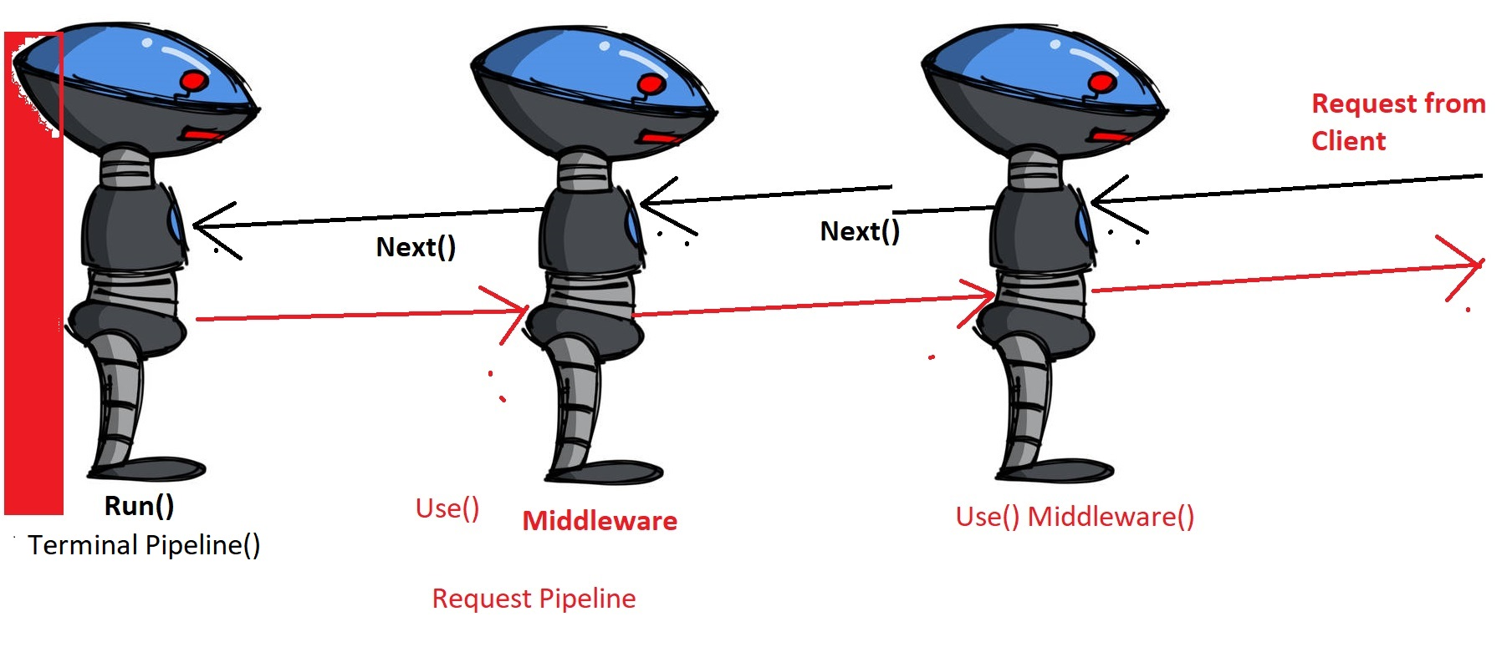
Middleware in Razor Pages
The Request Pipeline

Slide 11
Partial Pages
Partial Pages or Views are Razor files containing snippets of HTML and server-side code to be included in any number of pages or layouts. Partial pages can be used to break up complex pages into smaller units, thereby reducing the complexity and allowing teams to work on different units concurrently.
Creating Partial Pages
Partial pages are cshtml files that do not take part in routing. Therefore you can use any of the Razor templates to generate a partial page, except the Razor Page template that results in a PageModel file being created.
Rendering Partial Pages
Partial pages are included in the calling page in a number of ways. From ASP.NET Core 2.1, the recommended mechanism for including partial pages is the Partial tag helper:
<partial name="_MenuPartial" />
The name attribute takes the name of the partial file without the file extension, or the path of the partial. The value that you provide the name attribute is case-insensitive. The partial tag helper renders the content of the partial asynchronously thereby improving application performance.

Slide 12
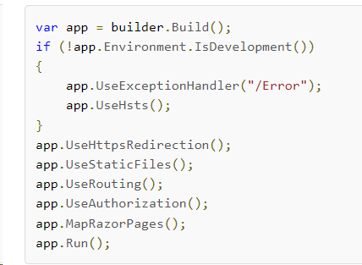
Request pipeLine Middleware Components:

Slide 13
The Html property also offers 3 other methods for rendering the content of partial pages: PartialAsync, RenderPartial and RenderPartialAsync. Both methods ending with Async are for rendering partials that contain asynchronous code, although the preferred way to render separate units of UI that are dependent on asynchronous processing is to use ViewComponents. Both of the methods with Render in their name return void whereas the other two methods return an IHtmlString (raw HTML). Therefore the Render methods must be called within a code block as a statement:
@{ Html.RenderPartial("_MenuPartial"); }
The Render methods result in their output being written directly to the response, so they may result in improved performance in certain situations. However, in the majority of cases, these improvements are unlikely to be significant, so the Partial and PartialAsync methods are recommended on the basis that you should strive to minimise the number of code blocks in your Razor page.

Slide 14
Models And Strongly Typed Partials
By default, the data passed to the partial is the view data for the current page. This includes its PageModel class, which is accessible via the partial's Model property, just like a regular Razor page. The default Model in a partial is a dynamic type, which can lead to runtime binding errors resulting from typos.
Just like standard Razor pages, partial pages support the @model directive specifying the type for the partial's data model, which enables you to strongly type the partial. It also enables you to specify a subset of the current page's data as the model for the partial. All of the rendering methods have overloaded versions that take a model to be consumed in the partial.

Slide 15
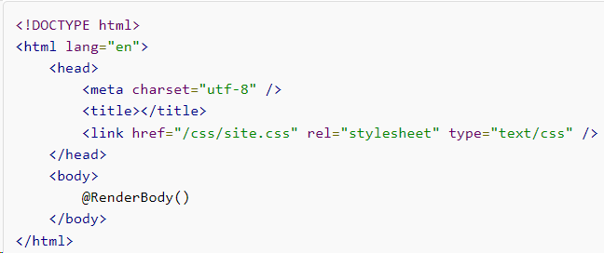
Layout Pages
The layout page acts as a template for all pages that reference it. The pages that reference the layout page are called content pages. Content pages are not full web pages. They contain only the content that varies from one page to the next. The code example below illustrates a very simple layout page:
What makes this a layout page is the call to the RenderBody method. That is where the result from processing the content page will be placed.

Slide 16
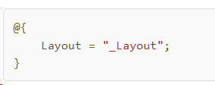
Content pages reference their layout page via the Layout property of the page, which can be assigned in a code block at the top of a content page to point to a relative location:
The value passed to the Layout property is either the name of the file without the extension, or the relative file path, rooted in the project.
ayout pages are typically named _Layout.cshtml, the leading underscore preventing them from being browsed directly. Standard practice is to specify the layout page in a _ViewStart.cshtml file, which affects all content pages in the folder in which it is placed, and all subfolders.

Slide 17
Sections
The RenderBody method placement within the layout page determines where the content page will be rendered, but it is also possible to render other content supplied by the content page within a layout page. This is controlled by the placement of calls to the RenderSectionAsync method. The following example of a call to this method is taken from the layout page that forms part of the default template Razor Pages site:
@await RenderSectionAsync("Scripts", required: false)
This call references a section named "Scripts" - intended for page-specific script file references or blocks of JavaScript code so that they can be located just before the closing </body> tag. The second argument, required determines whether the content page must provide content for the named section. In this example, required is set to false, resulting in the section being optional. If the section is not optional, every content page that references the layout page must use the @section directive to define the section and provide content:
@section Scripts{
// content here
}

Slide 18
Tag Helpers in Razor Pages
Anchor tag helper
Cache tag helper
Environment tag helper
Form Action tag helper
Form tag helper
Image tag helper
Input tag helper
Label tag helper
Link tag helper
Option tag helper
Partial tag helper
Script tag helper
Select tag helper
Textarea tag helper

